Slide 1
SUMMER PAY 2026
Business Offices and Payroll Centers

Slide 2
Agenda
Academic-Year Employment Summer Pay Policy
Roles and Responsibilities
Create and Review the Calendar
Manual Summer Calendars
Cost Distribution
Flat amounts – Regionals
Holiday Pay
FERAP Appointments
Payroll Lock/Retroactivity
Summer Pay Resources

Slide 3
ACADEMIC YEAR -
SUMMER PAY for 9 Month Faculty and Staff

Slide 4
Summer Pay Policy
Academic Year Employment Policy (V1.F.12)
AY appointments begin seven (7) calendar days prior to the first day of classes each Fall semester and ends on commencement day or the final date for submitting grade reports for the Spring semester, whichever comes later.
Academic-Year faculty and staff may be employed during the summer on any source of funding with the approval of their department or unit head. The following provisions also apply:
Sponsored program funding agencies may limit requests for summer support. All charges for work performed by employees on sponsored agreements must be allowable under the sponsored program agreement and be compensated based on the institutional base salary, as defined in the policy on Effort Reporting (II.C.1).
Compensation for academic-year employees on the West Lafayette campus who are employed during the summer will be based on the employee’s approved academic-year salary at the rate approved by the Board of Trustees. Refer to the Academic-Year Employment Pay Practices maintained by Human Resources for detailed information.
Compensation for academic-year employees on the Fort Wayne and Northwest campuses who are employed during the summer generally will be based on the employee’s approved academic-year salary at the rate approved by the Board of Trustees. An employee of one of these campuses who is performing only instructional duties, not part of sponsored program funding, may be compensated using a course rate applied in accordance with requirements set by the CFO and Provost. Refer to the Academic-Year Employment Pay Practices maintained by Human Resources for detailed information on both methods.
Refer to the executive memoranda on Compensation for Summer Intensive Instructional Activities and Non-Continuing Education Overload Activities (C-40) and Compensation Policies for University Staff Members Participating in Continuing Education Activities (C-18), as amended or superseded, for the compensation requirements pertaining to such employment activities.

Slide 5
Academic Year Employment Pay Practices - 1
These pay practices supplement the policy on Academic-Year Employment (VI.F.12)
Compensation for academic-year employees who are employed during the summer will be made at the rate of 2.778% per week of their approved academic-year salary rate. The salary of an employee who changes from AY to FY employment will be adjusted at the rate of 27.78% per approval by the Board of Trustees.
  Academic year faculty/staff contracted for 18 weeks/semester which is 36 weeks per academic year. Weekly pay is 1/36 of the academic year base pay which is 2.778%
In general, annual merit increases are effective for all employees on July 1. Academic-year employees who are employed during the summer will see the change reflected in their paychecks for pay periods that start on or after July 1. Exceptions to this practice may be stipulated in an individual’s employment contract.
In some cases, summer employment for instruction on the Fort Wayne and Northwest campuses may be compensated using a lump sum course rate that is dispersed over the pay periods during which the instruction occurs. Guidance on the appropriate use of this payment method will be established by the CFO and Provost. Lump sum rates for Regional campuses are not allowable when there is effort on Research during the pay period.

Slide 6
Academic Year Employment Pay Practices - 2
AY faculty can either teach summer courses or work on sponsored research to receive summer pay.
Academic faculty may be employed during the Summer for up to 13 weeks, providing there is funding to cover their time.
The faculty member determines the allocable source of funding for their summer salary.
Academic year employees are only paid for actual days worked and for holidays in a pay period in which they have worked during the summer. Academic year faculty do not accrue vacation time; therefore, they may not take vacation time as a paid status.
IMPORTANT: Academic BW employees annual merit increases need to be effective on the first day of the pay period in order to utilize Summer Calendars in SEEMLESS.

Slide 7
SUMMER PAYROLL SEEMLESS
The online SEEMLESS (Summer Employment and Effort Management Leading Efficiency through a Simple Solution) application is the solution used for Summer Pay.
All Employee information is transferred over to SEEMLESS from ECP as of the first day of summer and first day of each pay period.
The SEEMLESS application is accessible by both business offices and faculty through the OnePurdue portal. There is a faculty training video on the website.
        Summer Payroll - Human Resources - Purdue University
It is important to verify the salary prior to submitting the calendar. It is best practice to select the “Refresh Faculty Information” to update the current information into SEEMLESS prior to validation.

Slide 8
SUMMER PAYROLL SEEMLESS
Additional Information with SEEMLESS processing
Calendars are generated for AY Faculty/Staff (MO) and AY Grad Staff (BW) with EE Subgroups: ZE - Student 9 Month AY Salaried and ZZ - 9 Month AY Salaried. Academic Year (AY/AB) appointments follow the academic calendar, while Fiscal Year (FY) work through the full year.
If a Summer calendar is zeroed out, you will need to resubmit the calendar since SEEMLESS doesn’t reverse the entries unless the calendar is submitted.
      Submitting a calendar that has been zeroed out will generate an additional overpayment. Faculty and Business Office/Employment Center staff are encouraged to review the HR Overpayment Collection webpage for frequently asked questions and further clarification.
Merit pay salary needs to be refreshed in SEEMLESS prior to submitting the Summer Calendar. Therefore, it is best to wait until the Merit pay is posted in ECP and refreshed in SEEMLESS before completing the July/August calendars.
FERAP Wage Type (1025) – 2026 Summer Calendars will incorporate the wage type into the FTAR calculation on calendars. The Business office will need to verify this is included in the individual's wages prior to submitting the Summer calendar.

Slide 9
Roles and Responsibilities

Slide 10
Summer Pay Business Office & Payroll Centers
Business Office & Payroll Centers responsibilities
Ensure appropriate payroll calendars are completed for academic-year employees who will work during the summer period.
Route to the faculty for review and submit the calendar to Payroll.
Consult with Sponsored Program Services regarding agency funding stipulations for faculty and staff engaged in a sponsored project to ensure all charges during the summer period are allowable.
Ensure salaries for academic-year employees who work on a sponsored project during the summer period are recorded in accordance with the sponsored project agreement and compensated based on the institutional base salary.
Advise on Summer Pay in SEEMLESS and ECP concerns.

Slide 11
Business Office & Employment Center Access
Access to SEEMLESS will be determined by the user’s roles
Roles would be assigned to users with Z_PU_ECP_ACCT_MNGMT or Z_PU_ECP_BUDGET in conjunction with fiscal approver roles.
If you need access, send the request to SummerPay@Groups.Purdue.edu.
  P
          Pl
Please include the following with the request to process:
1. The Name and PERNR of the Business Office/Employment Center employee
2. The list of Cost Centers the employee will be responsible for in SEEMLESS
3. Type of access you are needing – Summer Pay and/or Effort reporting

Slide 12
Faculty Responsibilities
Faculty responsibilities:
Create calendars (for self and subordinates) for academic-year employees who will work during the summer period.
Route to the Business office for approval and submission to payroll. Faculty do not have the option to submit directly to payroll. Only the Business office can submit the Calendars.
Review and approve calendars created by the Business office.

Slide 13
Creating the Calendar

Slide 14

Create Calendar - 1
Access SEEMLESS through the OnePurdue Portal
Select Faculty Management
Search by either My Cost Centers or All Faculty Information
All PERNRs associated with the faculty will appear. SEEMLESS defaults to the MAIN appointment.
IMPORTANT NOTE: Business offices need to ensure that the total Summer Pay does not exceed 1.0 FTE across all PERNRs for any individual.

Slide 15

Create Calendar - 2
Pulling a calendar into SEEMLESS – Business office access needed
If you need to pull in a Summer Calendar for an individual that isn’t currently in SEEMLESS, you will need to verify that they are in ECP in an “Active” status.
This is important since the first date of them being active is when the calendar date will start.
Remember only Subgroups ZE and ZZ will have summer calendars.
Search for the individual under the Faculty Management tab, then in the upper right-hand corner, select to add the calendar.

Slide 16

Create Calendar - 3
Refresh the Faculty to update and select the 2026 Calendar period
Click on Calendar management, select the ALL TAB, then advanced search for the PERNR.
Verify the Full Time Annual Rate (FTAR) against ECP by calculating the Annual Salary in ECP divided by the CUL in ECP. Be sure to check for FERAP wages on the PERNR.
Selection of the Calendar definitions are on the left side (Research, Teaching, Other).
For each day summer pay is earned, select an entry indicating a half or full day of activity (ie: R, T, O).
Definitions for calendar entries should be selected based on the type of duties being performed and not based on the funding source.
Code the activity for the day by selecting the appropriate drop down with the Edit button. If selecting a template to populate the calendar, refer to the Manage Template QRG. Be sure there is only one set of codes per day.
Verify the calendar has the correct Daily rate calculated on the calendar. This is especially important on the FERAP appointments.
The Pay Summary is calculated by the daily rate (*) times the number (#) of days in the calendar. Holidays are automatically added to the pay period.

Slide 17
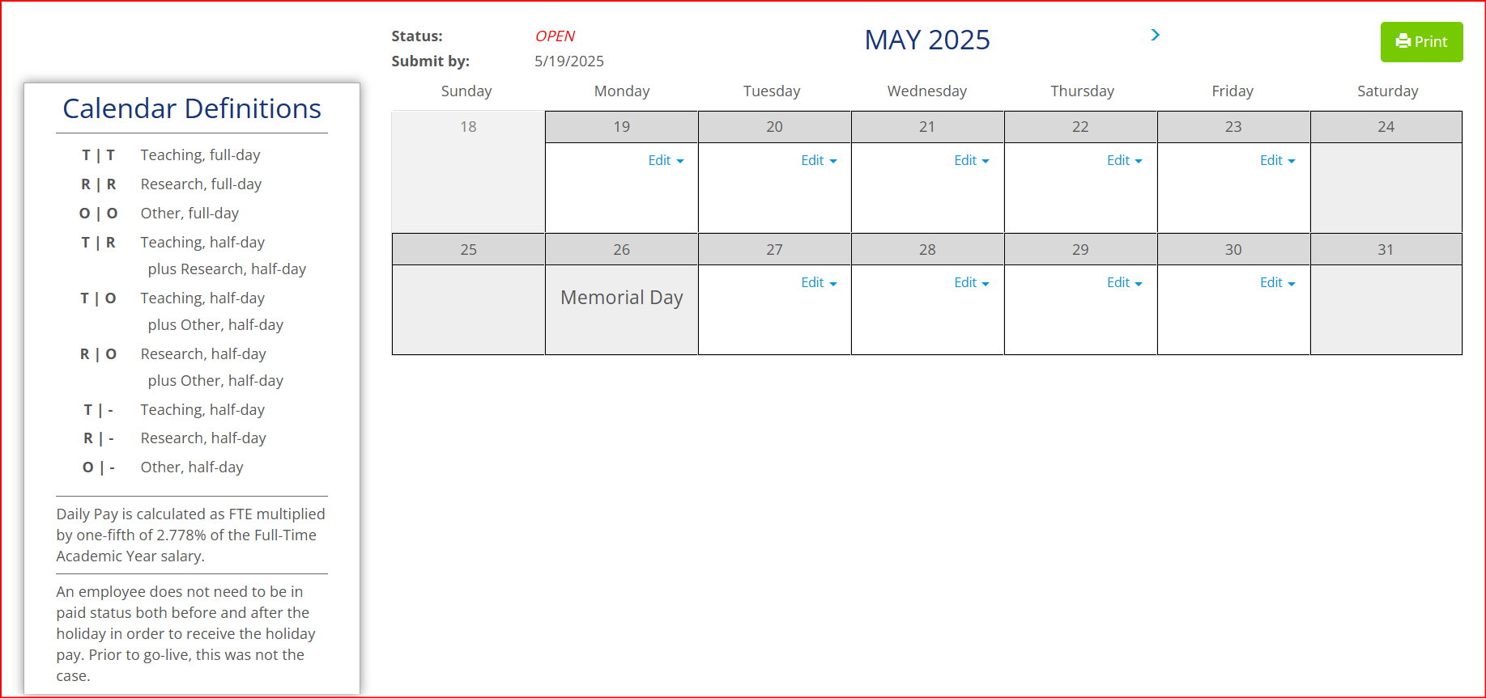
Create Calendar - 4
Populate the Summer Calendar

Slide 18
Create Calendar - 5
Summer Pay Calculations
Summer Pay is calculated per the University Policy as was approved by the Board of Trustees.
Compensation for academic-year employees who are employed during the summer will be made at the rate of 2.778% per week of their approved academic-year salary rate.
Summer Calendars will include the FERAP wage type (1025), so be sure to validate this.
Summer Pay is calculated as follows:
The Summer Pay calculation is described in the calendar definitions on the left side of the calendar in SEEMLESS
 | ECP Annual Salary |  | ECP CUL (FTE) |  | Full Time Annual Rate (FTAR) (B/D) |  | AY Summer Factor |  | AY Factor Salary (F*H) |  | Days |  | Daily Rate at Full Time (J/L) |  | SEEMLESS FTE |  | Daily Rate in SEEMLESS (N*P)
Example: | $51,125 | / | 25% | = | $204.500 | x | 0.02778 | = | 5681.01 | / | 5 | = | $1,136.20 | x | 0.25 | = | $284.05

Slide 19

Create Calendar - 6
Select send for Faculty Verification to forward the calendar to the Faculty to approve or submit directly to payroll.
Grad staff calendars adhere to the same process. However, they will be displayed as bi-weekly pay periods and the faculty and/or the Business office creates the calendars.
Concurrent Appointments with different rates of pay should be handled separately.
Regionals - Flat amounts can be selected for Teaching and Other, but not Research.
MERIT REMINDER: Calendars must be in an OPEN status before the new merit pay information can be refreshed into the calendar. July and August calendars should not be submitted until after the Merit load and SEEMLESS refreshed. All Open statuses are (Open/Re-Open/Business Review/Faculty Verification) in SEEMLESS. Processed calendars will not be refreshed.
  Business@Purdue articles will be released before the Merit load and associated SEEMLESS refresh with further guidance.

Slide 20
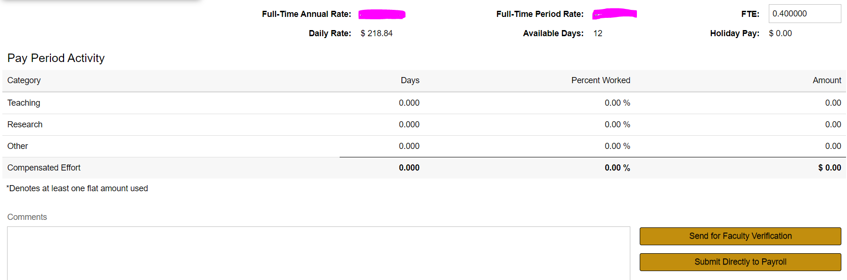
Calendar Summary
Verify the pay summary and submit

Slide 21
Reviewing the Calendar

Slide 22

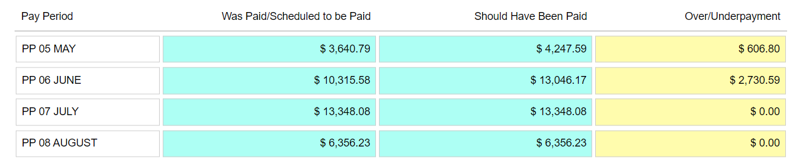
Reviewing the Calendar - 1
Summer Pay calendars where a change has been made by Faculty must be reviewed by the Business office prior to submitting to Payroll for processing.
Changes to the original information is displayed under the Retro Pay tab:
Submit the Calendar for payroll processing by the established pre-payroll task cutoff dates on the Payroll Calendar site.

Slide 23

Reviewing the Calendar - 2
After submitting the Calendar, the Business Office will need to verify the calendar entries in SAP/ECP IT0015 (additional pay)
In ECP/SAP, access PA20, enter the PERNR number
Type in Infotype 0015 and STY 1315 for Summer Pay, select the moon over mountain
Highlight the line to view, then click on the magnifying glass
On the additional payments tab, verify the amount posted matches to the SEEMLESS calendar amount. This will be a lump sum amount for EACH PAY PERIOD 2026 Summer Pay. Cost distribution will then follow IT27 in ECP.
There is also a COGNOS report that can be run to verify the entries in ECP Info type 0015 and wage type 1315. Remember that COGNOS data is populated a day in arrears, so you will not see entries from the current day:
If there is a discrepancy, contact summerpay@groups.purdue.edu

Slide 24

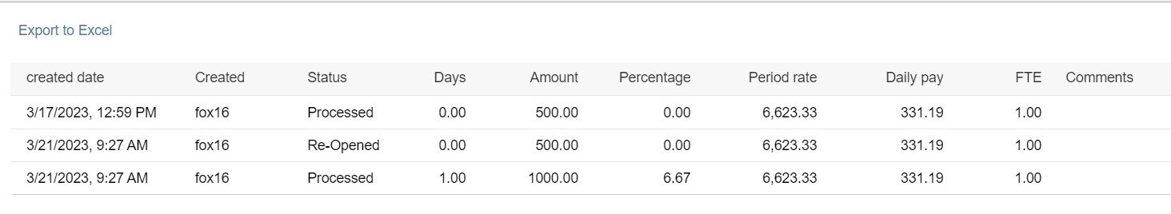
Reviewing the Calendar - 3
AUDIT trail
View the changes to the Summer Calendar by selecting the VIEW History tab:
The audit trail details when changes have been made to the calendar and can be exported

Slide 25
Verifying multiple Calendars are not > 1.0 FTE
SEEMLESS has a feature that allows the user to view the FTE by calendar period and pay period.
Example: Days column is hidden next to the FTE column in the first line:

Slide 26
Manual Calculator

Slide 27
SEEMLESS vs Summer Calculator
All Employee information is transferred over to SEEMLESS the first day of summer and the first day of each pay period. The summer calculator form along with a manual entry should be used when an effective date is after the first day of the pay period.
If you have the following situations: New hire, rehire, add additional, transfers, position reclassifications and change in pay with effective dates after the first of the pay period then:
Select the appropriate Summer Pay Calculator to be submitted for the pay period.
A paper calculator can be used for the first pay period and then the SEEMLESS application for the following periods.
All employee transfers in mid-pay period must be completed with a summer calculator
Do not enter Cost Overrides on manual entries in IT15 wage type 1315 for summer calculators. Cost Overrides in Summer Pay will not work with the Effort Reporting system.
A Summer Calculator Form is only necessary for employees with mid-pay period position reclassifications if the salary is affected. If the effective date is the first of the pay period, the employee may need to be added to the SEEMLESS application. Send this request for access to SummerPay@Groups.Purdue.edu including their PERNR #.
  NOTE: Only process a Summer Calculator if absolutely necessary. Otherwise, you should utilize SEEMLESS Summer Calendars.

Slide 28
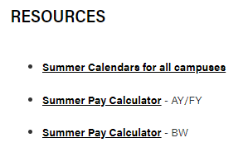
RESOURCES
REFERENCE LINKS
https://www.purdue.edu/hr/paytimepractices/summerpay/index.php

Slide 29
Cost Distribution

Slide 30
Cost Distribution - 1
Summer Pay posts according to Cost Distribution (CD) using IT27 in ECP.
Summer Pay posts as a lump sum on a single day within the pay period. That date is referred to as the Date of Origin. Generally, the Date of Origin will be the first day worked in the pay period; however, there are certain situations in which this may vary.
To ensure that the Summer Pay posts correctly, Cost Distribution MUST be the same for the WHOLE Pay period (BW & MO). This is different than cost distribution for FY employees and for all Fall and Spring employees which can have a different cost distribution entered for each day.
There is a cost distribution tool on the website to assist with calculating appropriate prorated percentages for an entire pay period. Summer Payroll - Human Resources - Purdue University

Slide 31
Cost Distribution - 2
It is very important that IT27 is populated correctly and according to the pay periods.
Summer Effort Reports (PARs) are no longer be tied to the Summer Calendar in SEEMLESS. They will pull from ECP pay results just like the Fiscal Year PARs and all Fall and Spring PARs. Changes to Summer AY Effort Reports (PARs) write back to IT27 in ECP.
It will be very important to ensure that there are NO Cost Overrides on manual Summer Pay entries into IT15 wage type 1315. If there are Cost Overrides entered for Summer Pay the Effort Reporting system will not be able to update payroll postings to match a certified Effort Report (PAR).

Slide 32
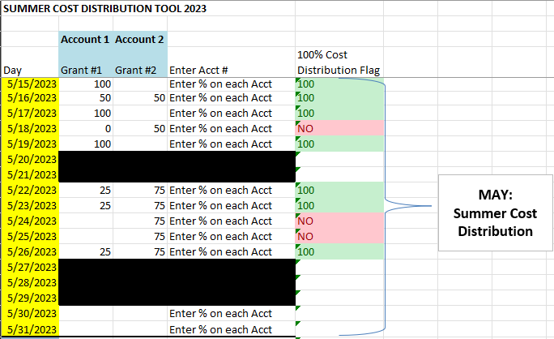
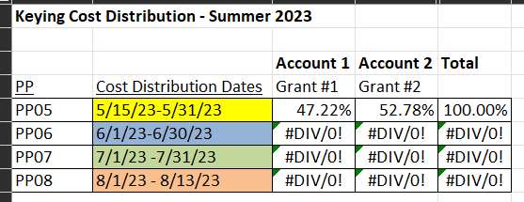
Cost Distribution – Summer Pay IT27
As a reminder: After the Summer Calendar is submitted in SEEMLESS, verify the salary posted properly to IT15 Wage type 1315 in ECP
Then, it is important to remember that CD must be the same for the whole pay period. The BO will key the average of the cost distribution for the period into IT27 for that entire pay period.
The CD tool for your respective campus is a very helpful tool to arrive at the cost distribution to key into IT27. To use the CD tool, input the daily CD into the spreadsheet, verifying each line totals 100%. The tool will calculate the CD percentages to enter for each pay period.

Slide 33
Regional Campus Flat Amounts

Slide 34
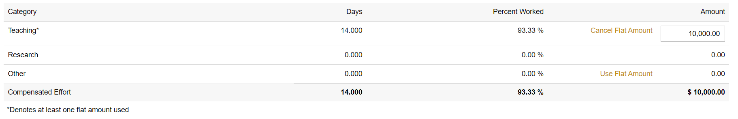
FLAT Amounts - 1
Regionals: Purdue Northwest & Ft. Wayne
Flat amounts are used by PNW & PFW ONLY and can be utilized for Teaching and Other categories. Flat amounts can not be used when there is Research on the Summer Calendar.
Select the Use Flat amount when inputting a value.
After the flat amount is entered, the option appears to Cancel Flat Amount.

Slide 35
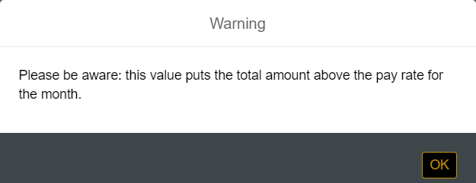
FLAT Amounts - 2
Regionals: Purdue Northwest & Ft. Wayne
If the Summer Calendar amount exceeds the Full-time Period rate, you will receive the following warning:
If this is correct, then click OK to process the calendar.

Slide 36
Holiday pay Explained

Slide 37
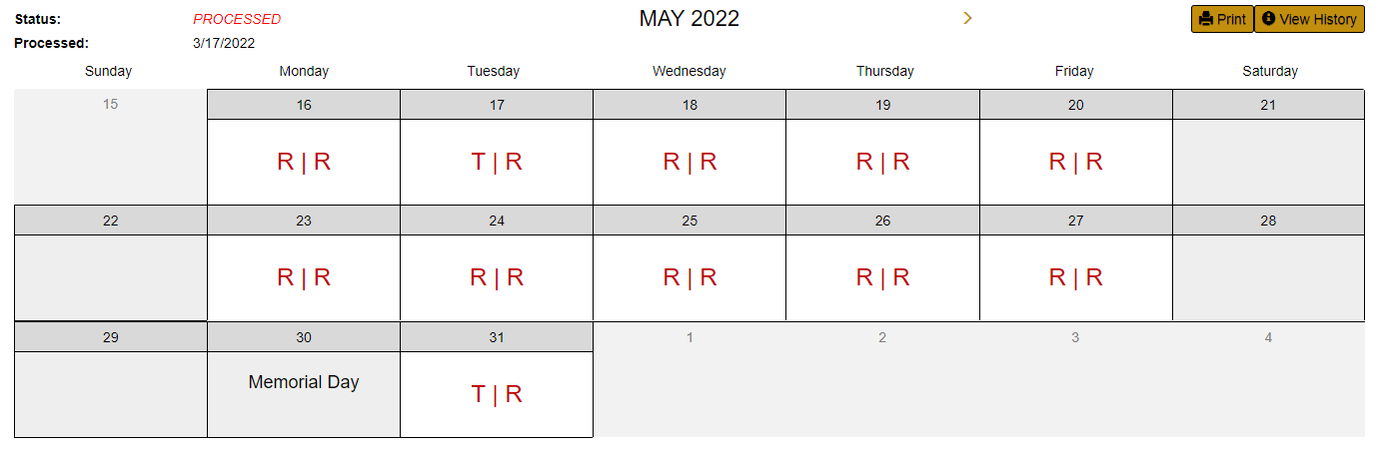
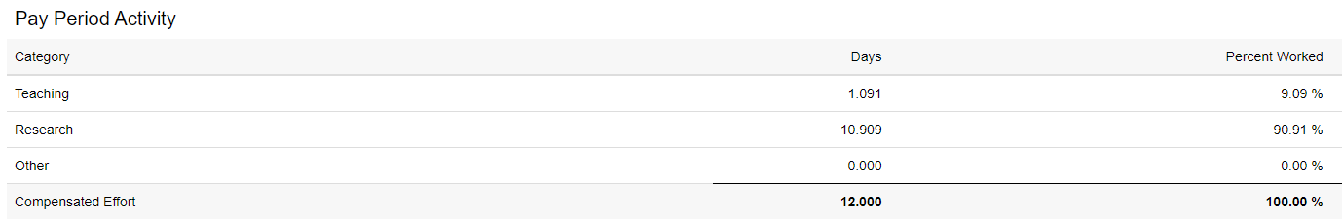
Holiday Pay
Holiday Pay is paid if the employee works anytime during the pay period.
For the Regionals, when a flat amount is entered, the Holiday pay is to be considered in the flat amounts. Holiday pay will not be added on top of the flat amount.
Holiday pay is allocated across the various categories -
Holiday Pay Calc: | Full days | Percent Worked | Days
Teaching | 1 | 9.09% | 1.09
Research | 10 | 90.91% | 10.91
Other | 0
Holiday | 1
Totals | 12 | 100.00% | 12.00

Slide 38
Faculty Enhanced Research Appointment Program - FERAP

Slide 39
FERAP – Faculty Enhanced Research Appointment Program
FERAP appointments recognize research focused efforts, duties and activities of tenured and tenure-track faculty that advance the Purdue research enterprise.
FERAP is a concurrent faculty appointment allowing for up to .75 FTE to be established at a salary up to 25% higher than their current institutional base salary.
It is VERY Important for the Business office to verify that an individuals Summer Calendars are not > 1.0 FTE. This can be checked by extracting the calendar information from the ALL tab by career account and viewing the submitted calendars by pay period. If their total is > 1.0 FTE across all PERNRs, then you will need to adjust them accordingly.

Slide 40
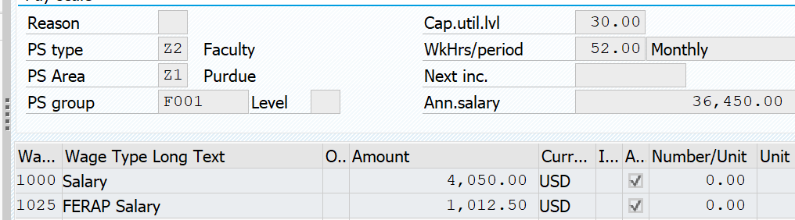
Faculty Enhanced Research Appointment Program Example
The FERAP appointment is added into the base wages of the PERNR and is then calculated based upon the CUL% in ECP. This shows PERNR 10014197 as a separate PERNR with 70% CUL and then PERNR 10077747 is the FERAP PERNR appt and is added into the base wages.
ECP FERAP shows both:

Slide 41


FERAP
Faculty Enhanced Research Appointment Program Example in SEEMLESS

Slide 42
Retroactivity Payroll Lock

Slide 43
Retro Activity Payroll Lock - 1
Due to the retro lock process effective on 2/1/26, payroll will be locked to retro activity prior to July 1, 2024 and then on a rolling lock back the previous 18 months in 6-month intervals.
If you need to submit a Summer calendar prior to this date, you will need to complete a retroactivity exception form in DocuSign, attach the supporting documentation, obtain approvals and send to payrollpayments@purdue.edu for processing.
Some situations, such as Payroll, will be treated as exceptions, and changes will be allowed prior to the retroactive limits.
The supporting documentation should include the individuals PERNR #, retro date, accounts, and the reason for the request to pay the individual pay and approvals.
If the pay will be posting to a grant, you will need to attach that SPS will allow charging to the grant with the supporting documentation.

Slide 44
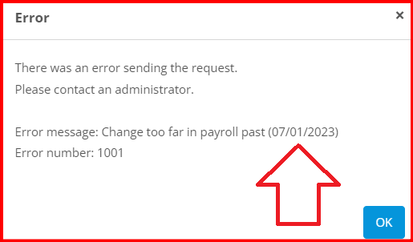
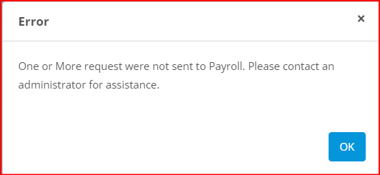
Retro Activity Payroll Lock - 2
Summer Calendar Error message you will receive when attempting to submit a retro calendar that will not process:
You will need to submit a retroactivity exception DocuSign form with the supporting documentation and approvals on why the payroll is being requested to payrollpayments@purdue.edu.
Once the retro activity is approved and the PERNR is unlocked, you will be able to submit the Summer Calendar in SEEMLESS for processing. The original entry for the calendar should reverse in ECP, so be sure to check this happens. Then the new calendar should post in ECP.

Slide 45
Retro Activity Payroll Lock - 3
Potential Scenarios:
Calendar was previously submitted prior to the lock date and you want to make changes. You will need to complete the Retroactivity exception form in DocuSign for approval with the attached approvals and supporting documentation and send to payrollpayments@purdue.edu . Upon approvals, the PERNR will be unlocked by payroll and the Summer calendar can be submitted in SEEMLESS for processing.
Submitting a “new calendar” - Seemless will not be able to pull in or process any new calendars prior to the lock date. You will need to complete the retroactivity exception form in DocuSign and send to payrollpayments@purdue.edu. Upon approvals, complete a manual Summer calendar and attach the approvals and supporting documentation.

Slide 46
Reminder and Tips

Slide 47
Important Reminders and Tips
Remember to release the calendars when you are finished by selecting the HOME tab in the upper left-hand corner.
Be sure to check the calendars for any duplicate codes as this will cause the pay to not be correct.
Reopened calendars – if a calendar is reopened, it must be submitted in the system, otherwise, the correct entries won’t post and will cause an overpayment.

Slide 48
Summer Resource Pack

Slide 49
Summer Calendar DATES
2026 Summer Calendars should be available in Mid April.
Deadlines for submitting Summer Pay Calendars is in accordance with the established Pre-payroll task cutoff dates on the Payroll Calendar Date site. You can view these dates on the SEEMLESS calendars in the upper left-hand corner of the calendar.
2026 Summer Pay dates: AY appointments begin seven (7) calendar days prior to the first day of classes each Fall semester and ends on commencement day or the final date for submitting grade reports for the Spring semester, whichever comes later.
Campus | AY Summer Start date | AY Summer End date
West Lafayette | 5/18/2026 | 8/16/2026
Fort Wayne | 5/14/2026 | 8/16/2026
Northwest | 5/13/2026 | 8/16/2026

Slide 50
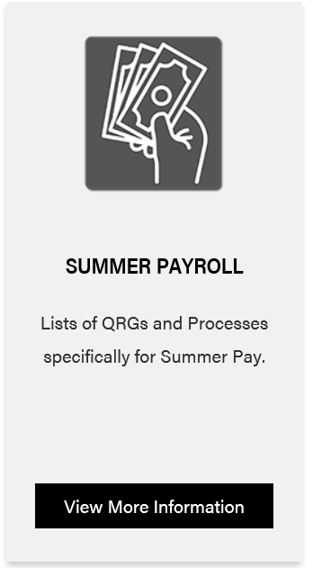
RESOURCES - 1
REFERENCE LINKS
https://www.purdue.edu/hr/paytimepractices/summerpay/index.php

Slide 51
RESOURCES - 2
SummerPay@groups.purdue.edu
For SEEMLESS Summer Calendar issues (Access, Refresh)
PayrollPayments@Purdue.edu
For Payroll center and Business office pay questions
Paspec@Purdue.edu
For Payroll changes (Base Pay changes, ECP and IT issues, Manual Summer Calculators)

Slide 52
Questions

